Slide 1
Here is the training of thought about Convolutional Neural Network (CNN)

Slide 2
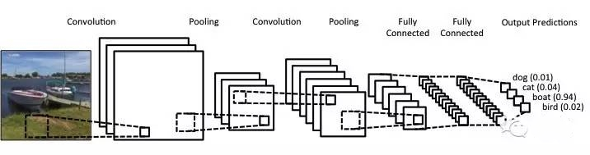
Convolution
Pooling
Flattening
Full connection

Slide 3
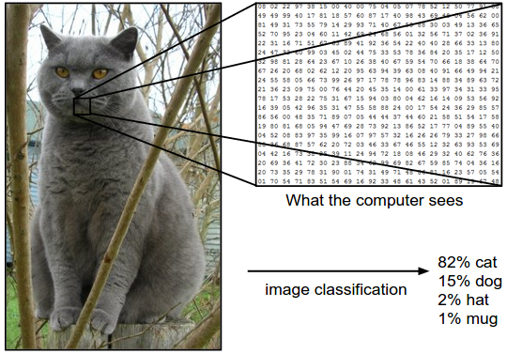
Convolution

Slide 4
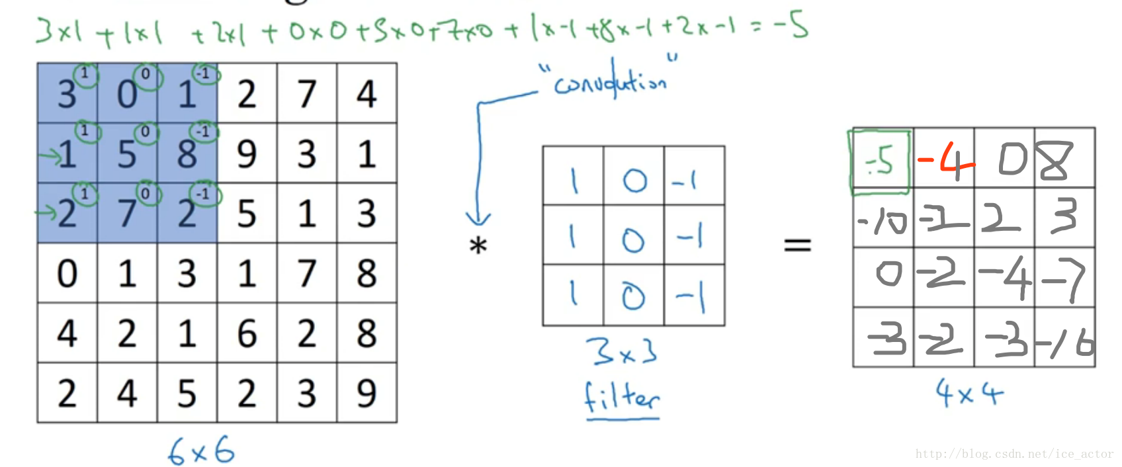
Convolution

Slide 5
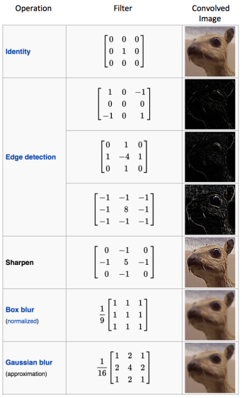
Convolution kernel

Slide 6
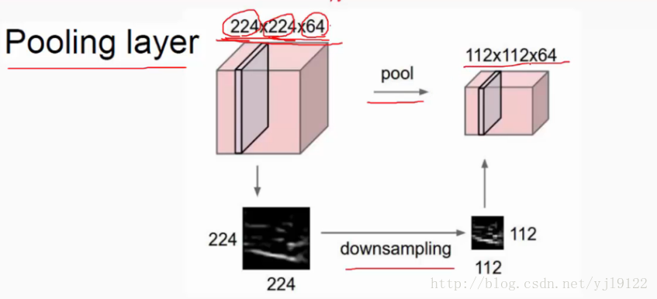
Pooling

Slide 7
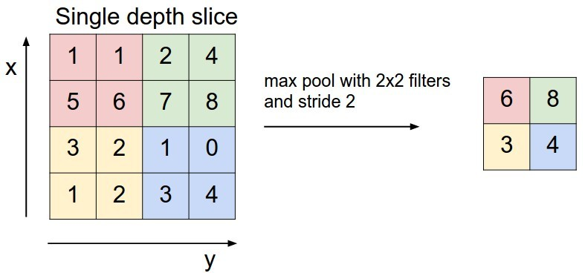
Pooling
Max pooling

Slide 8
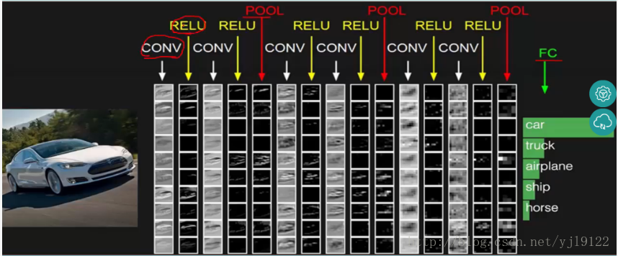

Slide 9
References
[1] https://medium.com/@tifa2up/image-classification-using-deep-neural-networks-a-beginner-friendly-approach-using-tensorflow-94b0a090ccd4
[2] https://becominghuman.ai/building-an-image-classifier-using-deep-learning-in-python-totally-from-a-beginners-perspective-be8dbaf22dd8
[3] https://blog.csdn.net/oxuzhenyi/article/details/73480448
[4] https://blog.csdn.net/oxuzhenyi/article/details/73480478
[5] https://www.sumaarts.com/share/620.html
[6] https://papers.nips.cc/paper/4824-imagenet-classification-with-deep-convolutional-neural-networks.pdf

